Slide 1

Wunder To-Do
Post-mortem of an Alexa skill for integration with Microsoft To-Do
Jens Bühl

Slide 2
Gliederung
Motivation
Technology and Concept
Implementation
Challenges
Status and Outlook

Slide 3


Motivation (1)
Cloud-based task management
Available everywhere
Always up to date
Easy sharing with family members
Until 2015: Use of Wunderlist, 6Wunderkinder, startup from Berlin.
2015: Microsoft buys 6Wunderkinder including Wunderlist
Further development of Wunderlist is stopped
Features slowly migrate to Microsoft To-Do until today
Quelle: wunderlist.com, todo.microsoft.com

Slide 4

Motivation (2)
Alexa finds her way into our home as a gift
Technical interest: How do these skills work?
Use Case: Shopping list without pen and paper?
Filling the list by voice command?
Moderately usable skill for Wunderlist
No Skill for Microsoft To-Do
New Alexa Skill to be developed
Learning new technology
Solution for above mentioned use case
Avoid cumbersome commands
Quelle: amazon.com

Slide 5
Technology and Concept (1)
„Normal“ Alexa Skills
„Intents“
„E.g.: "AddElementOnShoppingList “
Several "Utterances" per Intent
E.g.: “Put {placeholder} on the shopping list?"
Per Skill one "Invocation" name
E.g. "Wonder To-Do"
Problem
Invocation would be cumbersome: "Alexa, start Wunder To-Do and write apples on the shopping list"
Intentlogic and recognition would have to be developed by yourself
Lösung: List-Skill
No own intents for list management
Use the internal Alexa list management and processing of list events

Slide 6


Technology and Concept (1)
monitors
runs on
Alexa User
activates
interacts with
ASK SDK, json
(Item added)
MS Graph API, json
(Add item)
link accounts
Quelle: wunderlist.com, todo.microsoft.com, amazon.com

Slide 7
Technology and Concept (2)
Prerequisites
Amazon Developer Account (access to Alexa SDK)
Amazon Web Services Account (Lambda und Cloudwatch)
Microsoft Account (access to Microsoft To-Do, Account Linking)
Microsoft App Registration (access to MS Graph API)
Creation and management
Alexa Developer Console (link)
Web based, no List-Skills
Alexa Skills Kit CLI (link)
local, terminal based, List-Skills supported
Target SDK (link)
ASK SDK for Node.js

Slide 8
Implementation
Microsoft Visual Studio Code
Visual Studio Team Services
VCS: Git
Task management
Collaboration platform
(planned) Continuous integration / Test automation
Amazon Web Services
Lambda with node.js runtime
Monitoring with CloudWatch
Alexa Developer Console
Manual testing

Slide 9
Challenges
Certification process
Lengthy
Different "activation word" limits per region
Test accounts for all regions
Answers seem arbitrary - sometimes resubmission helps
Account Linking
3rd party provider needs own landing page (link) (link)
Landing page has to be hosted by the provider
Privacy policy had to be created and linked
Alexa account linking does not allow redirection (no business accounts possible)

Slide 10
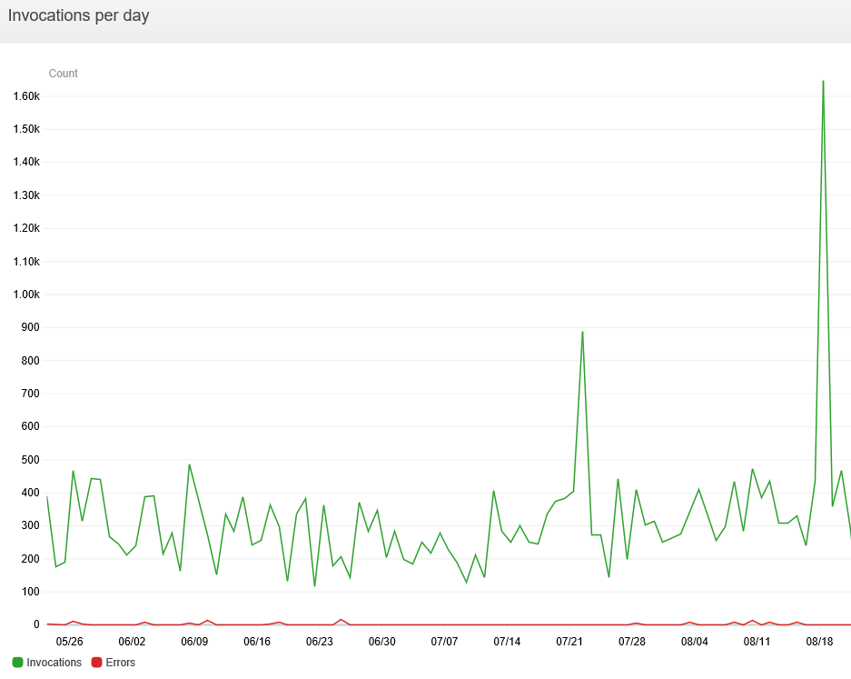
Status 2018-06 and outlook (1)
Online for 6 months
Ca. 500 invocations per day

Slide 11
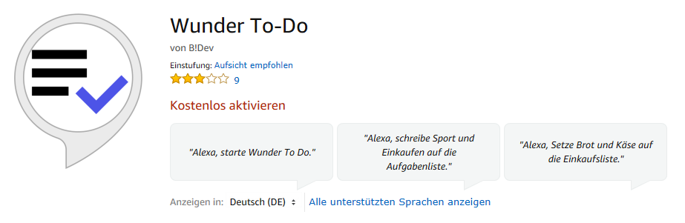
Status 2018-06 and outlook (2)
Available in all regions (except Japan)
Positive feedback
Better rated than the Wunderlist skill mentioned in the beginning
Negative reviews due to known limitations

Slide 12
Status 2018-06 and outlook (3)
2-Way Sync
Full synchronization between Alexa and MS To-Do lists
Currently blocked by Microsoft
WebHooks for tasks currently not supported in Graph API
Delta Queries for tasks currently not supported in Graph API
Support for business and school accounts
As soon as the Alexa linking process allows it
...or a workaround is found

Slide 13
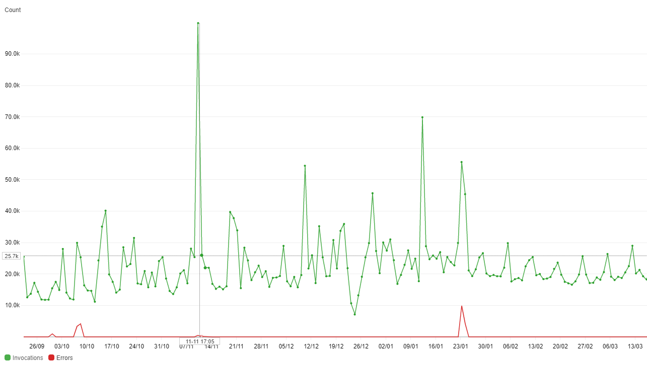
Status 2021-03 and outlook (1)
Ca. 20k invocations per day
X40 since 2018
15-20k unique users

Slide 14
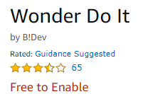
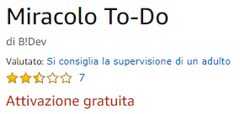
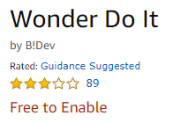
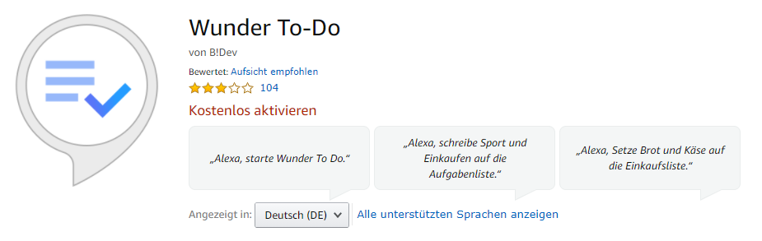
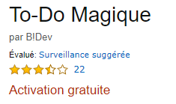
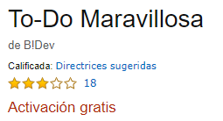
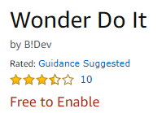
Status 2021-03 and outlook (2)
In use worldwide
Mostly positive feedback
Main criticism: Missing 2-way synchronization
Recent: Missing support for umlauts due to API changes
Challenge: Adaptation to new MS Graph API
Existing API will be switched off in 2022 at the latest

Slide 15
Thank You!
Start of the skill: Approx. January 2018
Deactivation of the skill: April 2021
Skill (was) to be found under
https://www.amazon.de/B-Dev-Wunder-To-Do/dp/B07BHLPLGD

